Slide 1
MY SEARCH ENGINE (TOGGLE)
NAME:- PARAKH MAHAJAN
NUID:- 001236045
DATA STRUCTURES AND ALGORITHMS
FINAL PROJECT PPT

Slide 2
DESCRIPTION ABOUT PROJECT
The objective of the project is to search text and as well as trade-off between accuracy of the results and performance speed. Here I first parsed all the document in metadata using Apache TIKA and than extract the data from that document for indexing and searching using Apache LUCENE data structure. Here I used different properties of lucene for indexing at the world level and search the keywords from that indexed documents. Here I also implemented a intuitive UI to facilitate the search using Servlet and JSP. Here I used golden set of documents in my dataset like pdf, docx, xml, html, txt, json. I also implemented the option for searching multiple queries at one time using conjunction, disjunction and negation operator. The search page will display the name of the file, path of the file, snippet and the ranking score of that document.

Slide 3
TOOLKIT USED IN PROJECT
APACHE LUCENE
APACHE TIKA

Slide 4
APACHE LUCENE
Apache Lucene is a high-performance, full-featured text search engine library written entirely in Java. It is a technology suitable for nearly any application that requires full-text search, especially cross-platform. Lucene offers powerful features through a simple API like scalable and high-performance indexing; powerful, accurate and efficient search algorithms and cross platform solution.

Slide 5
APACHE TIKA
Apache TIKA is a toolkit that detects and extracts the metadata and text over a thousand different files. All of these files types can be parsed through a single interface making it useful for search engine indexing. In my project I used latest version of Apache TIKA 1.16 .

Slide 6
ANALYSIS USING PRECISION AND RECALL
For analysis I calculate the precision and recall of all the indexed document using TrecJudge. Precision is the fraction of relevant instances among the retrieved instances, while recall is the fraction of relevant instances that have been retrieved over the total amount of relevant instances. Both precision and recall are therefore based on understanding and measure of relevance. TrecJudge compares the indexed document and calculate the precision and recall for a particular search query.
The average precision for all the documents is 0.707 and recall comes out to be 0.900.

Slide 7
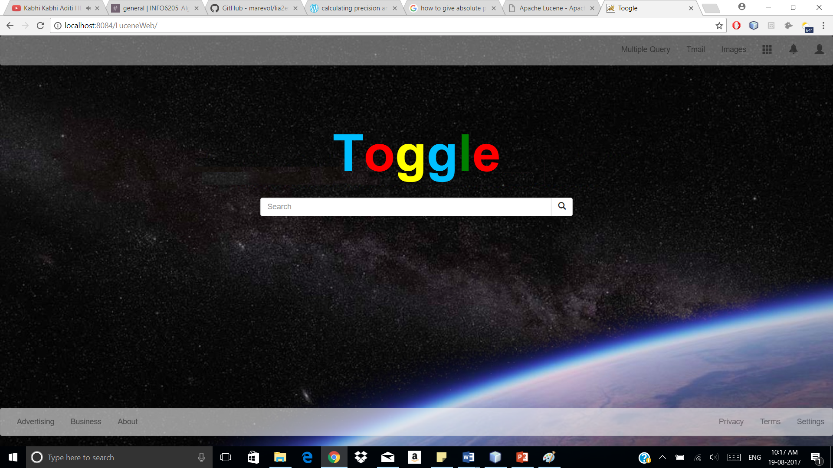
SCREENSHOTS OF THE PROJECT

Slide 8
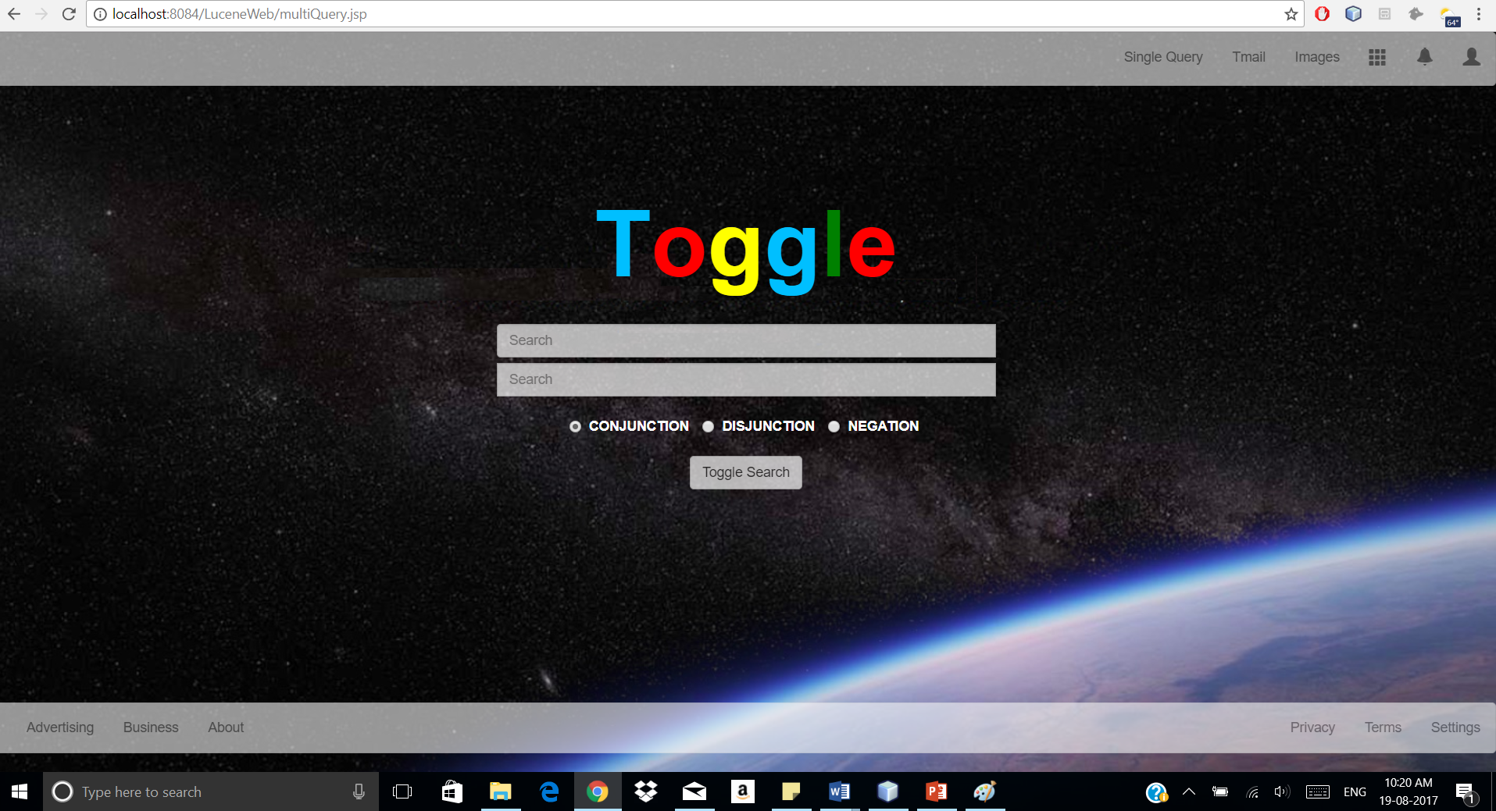
SCREENSHOTS OF THE PROJECT

Slide 9
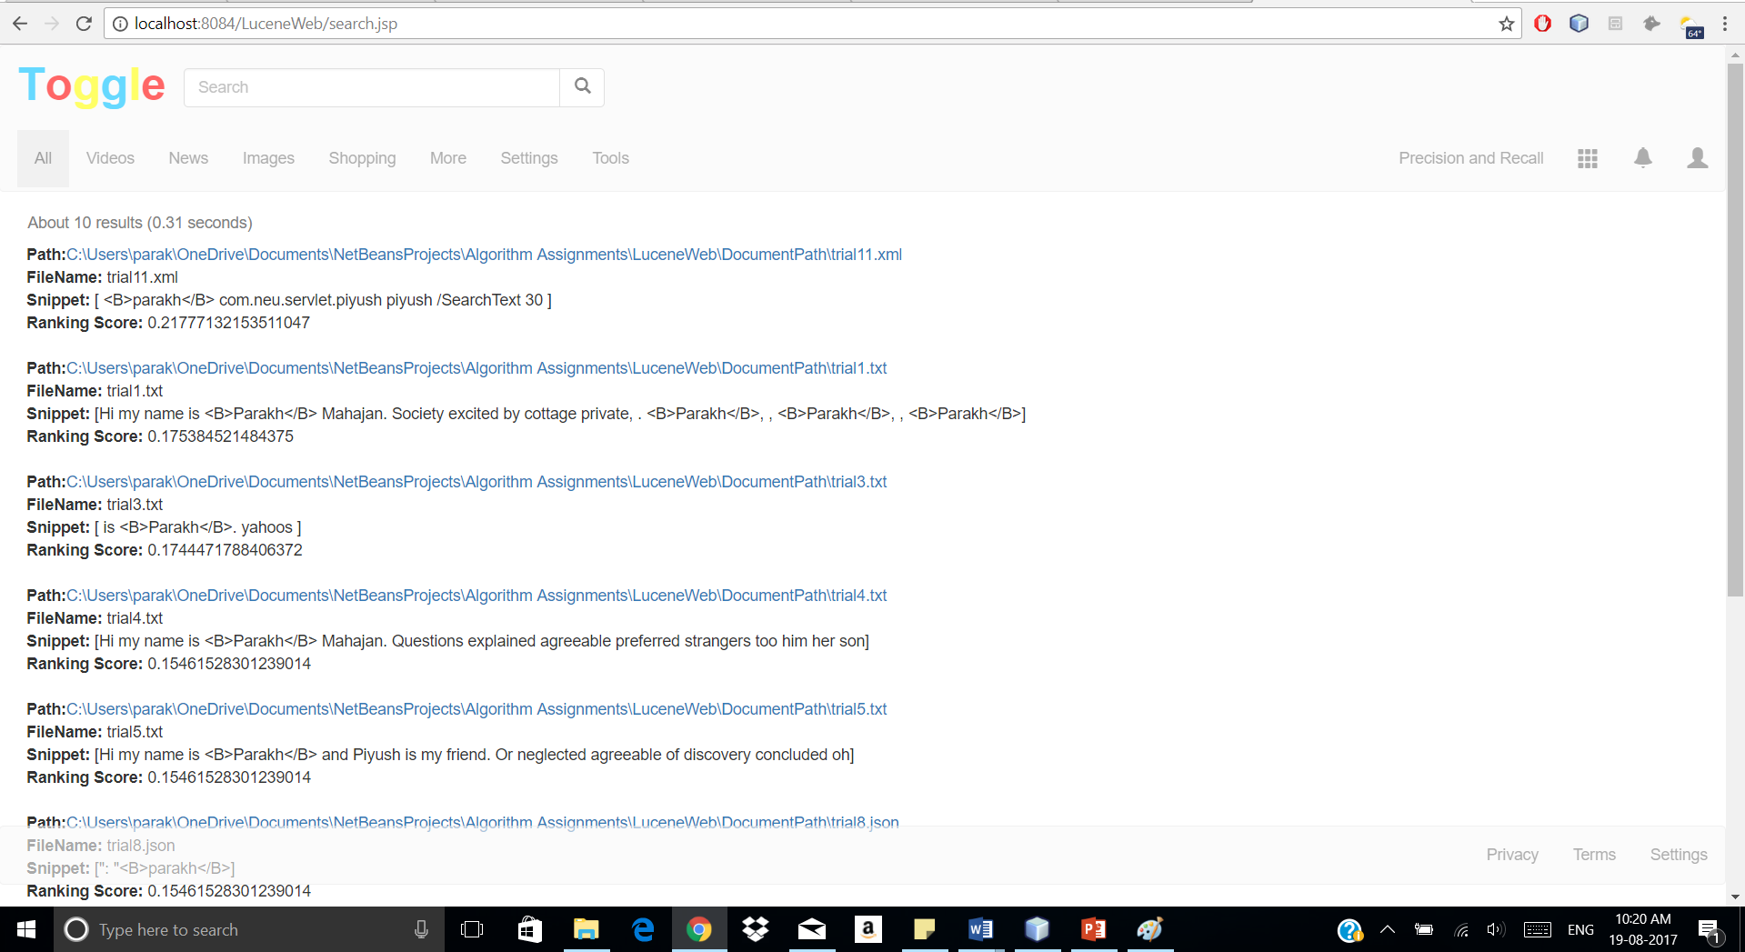
SCREENSHOTS OF THE PROJECT

Slide 10
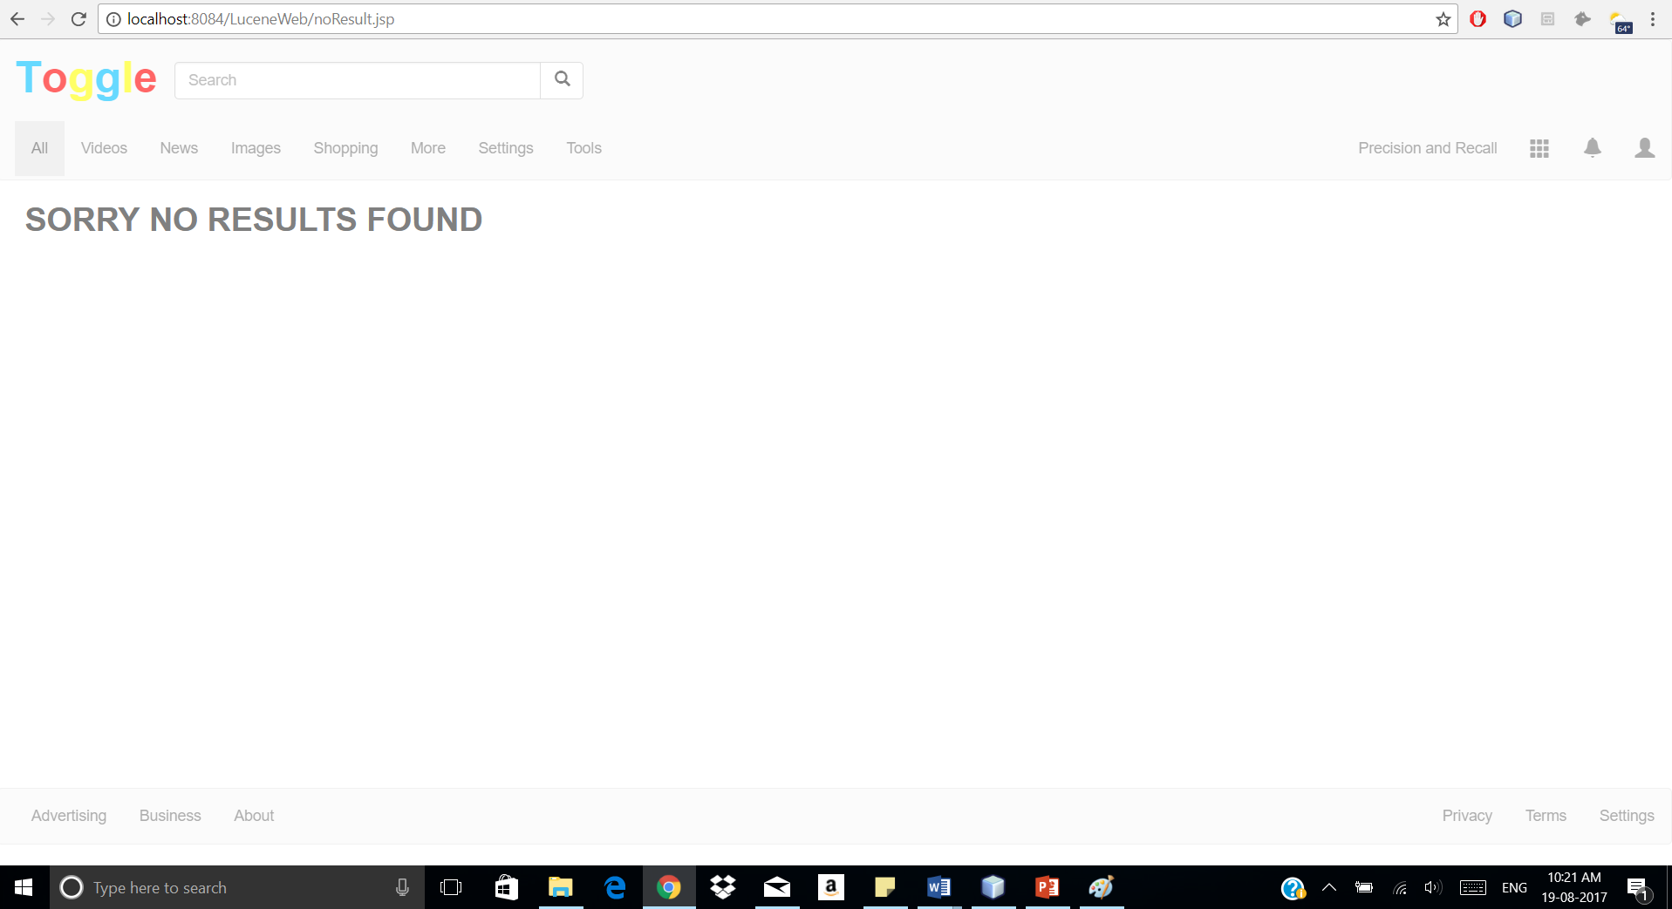
SCREENSHOTS OF THE PROJECT

Slide 11
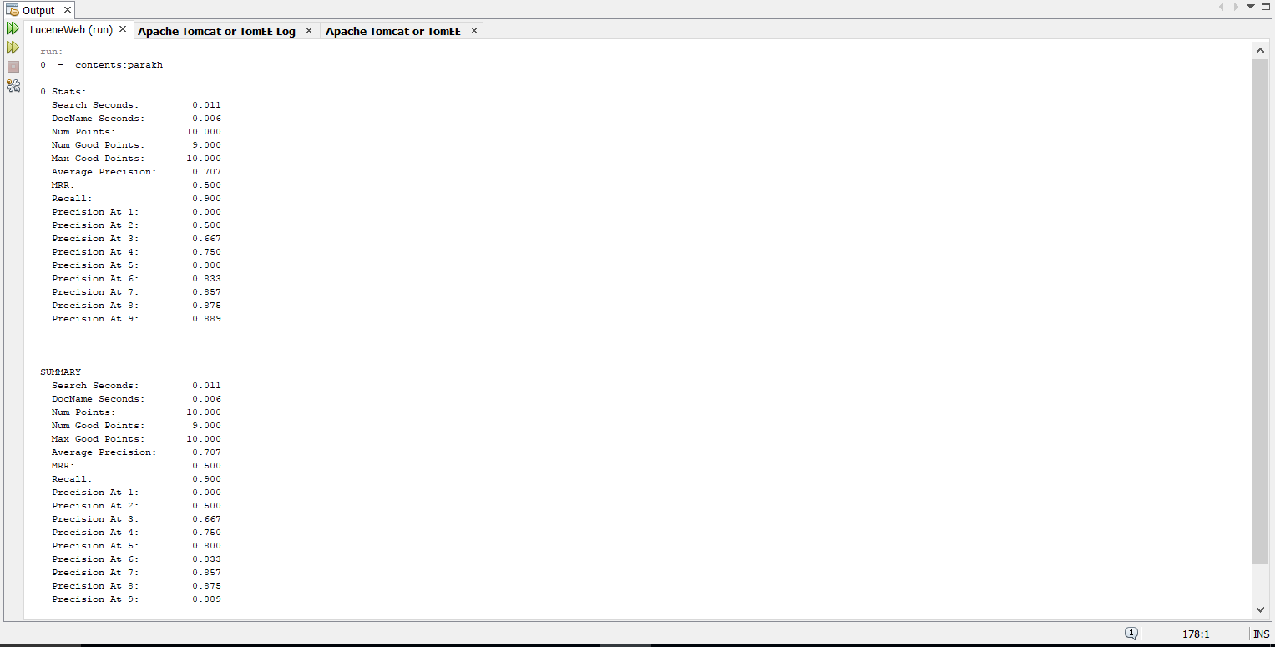
SCREENSHOTS OF THE PROJECT

Slide 12
THANK YOU

